Slide 1
SiteSeekers
Presented by Arif Manawer, Cameron Jardine, Mohammed A. Al-Muqsit, Munjer Masrur, Aquib Zaman
Pin: 1903

Slide 2
Idea

Slide 3
What
SiteSeeker is a platform for employers to hire construction workers.
Workers or contractors who are currently looking for work or have free time can look to complete jobs posted by employers.
SiteSeeker serves as a centralized platform for employers to easily find qualified workers who are looking for more opportunities.

Slide 4
Why
As a career group with little representation, we decided to make construction workers the central target for our application. With the introduction of our application, we can introduce construction workers to more opportunities, allowing their business to be seen, recognized, and ultimately acquire more jobs.
According to the Associated Builders and Contractors, an estimated 500k+ workers are needed on top of normal pace of hiring.

Slide 5
User Flows

Slide 6
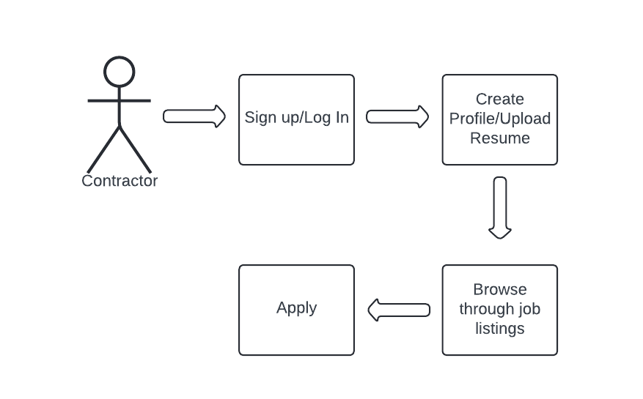
User Flows

Slide 7
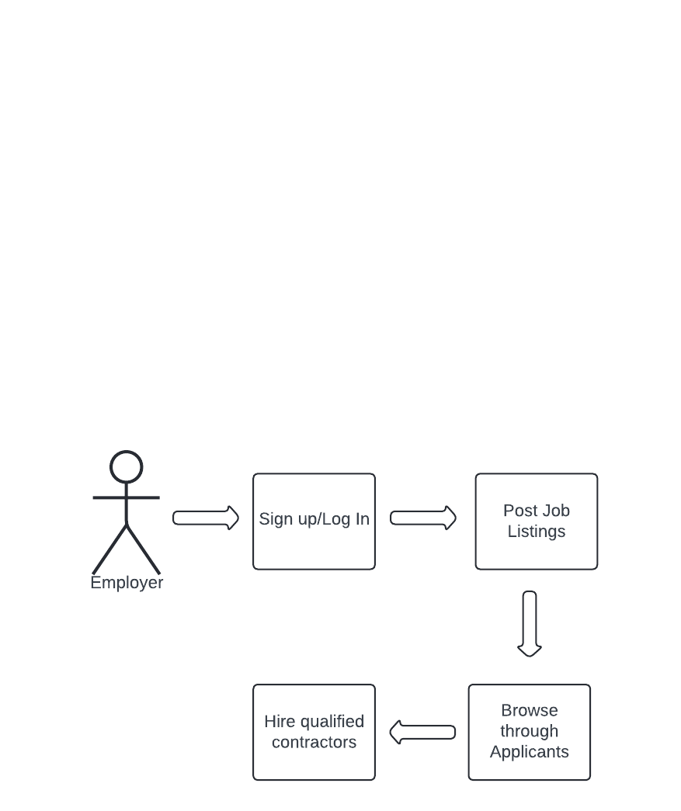
User Flows

Slide 8
Data
Modeling

Slide 9
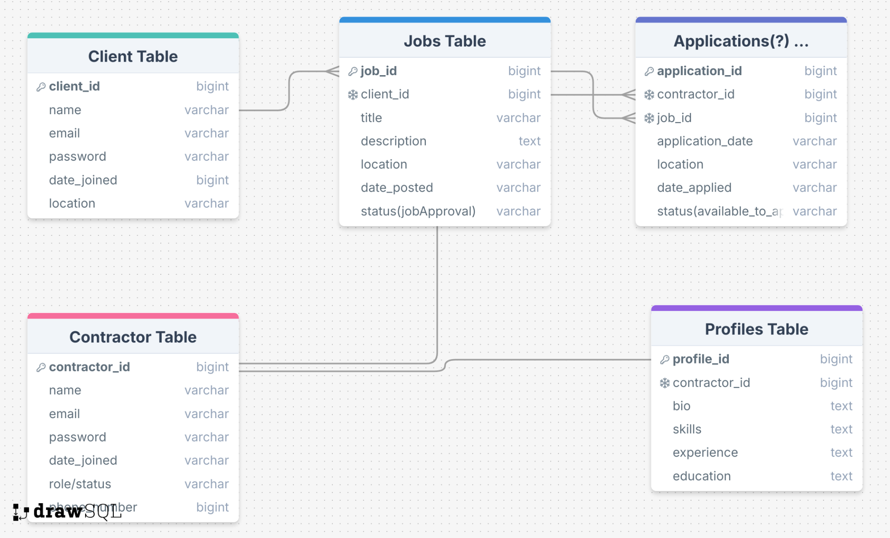
Relational Data Model
Based on our user flow, the (2NF) )relational data model should be partitioned as such:
A Client should be able to post multiple jobs
Each job may have multiple applications from different Contractors
Contractors may have multiple applications but can only have one for each job
Each contractor has one profile

Slide 10
Tech Stack

Slide 11



Tech Stack
We are using React for the frontend. React is a JavaScript library that allows you to build dynamic and responsive UIs. It is straightforward and there are many resources to learn it quickly.
For the backend, we are using Flask. Flask is python based and allows for ease of use and collaboration due to its readability.
We are also using Tailwind to style our frontend. Tailwind is very flexible with styling and we can customize the UI to our liking.

Slide 12

Database Management
MySQL is a relational management system that is easy to use, reliable, and also scalable. It has high performance without sacrificing functionality. It supports ACID transactions and is open source.

Slide 13
Member
Roles

Slide 14
Member Roles
Arif - PM/Backend
Mohammed - Backend
Cameron - Frontend and Database
Aquib - Frontend
Munjer - Frontend

Slide 15
Q&A?

